Slide 1
CS 97 Discussion 1B
Week 5
TA Howard Xie

Slide 2
Announcements
CS97 Midterm is over at 4pm PST today (Yay to those who finished!)
Assignment 4 - Git released soon?

Slide 3
Today’s Agenda
Git overview
Go over basic Git commands
Git demo
Installing Git
Learning assistants go through Git worksheet

Slide 4
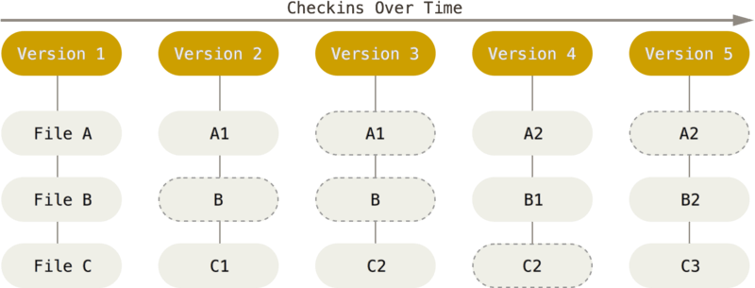
Git - A Version Control System

Slide 5
Git - Two States
Tracked
Files that were in the last snapshot
Simply put, files that Git knows about
All files will be tracked when first cloning an existing repository
Untracked
Everything else
Files that are not in the last snapshot and not in the staging area
New files created in the Git working tree will be untracked until staged

Slide 6
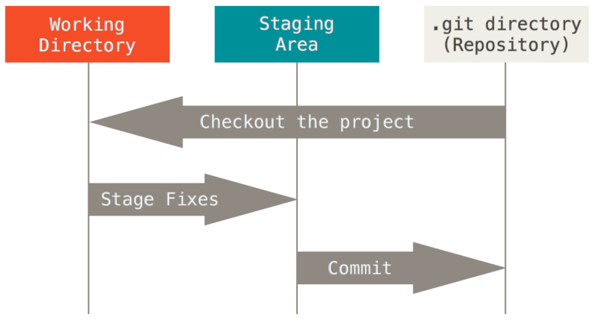
Git - Three Main Sections
Working Directory: also called working tree; files are in a modified state
Staging Area: files are in a staged state
Git Directory: files are in a committed state (a snapshot / version)

Slide 7
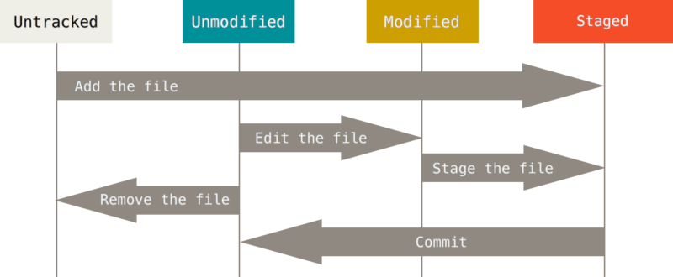
Git - Putting It Together

Slide 8
Git - Commands
git init <directory>
Create a git repo at <directory>
git clone <repo>
Clone repo located at <repo> onto local machine
git status
List files that are staged, unstaged, or untracked
git add <directory>
Stage everything in <directory> for committing. Can also specify a single file rather than a directory.
git commit -m “commit message”
Commits all staged files and uses “commit message” as the commit message

Slide 9
Git - Commands (cont.)
git log
Displays the commit history
git branch <branch>
Creates a new branch with the name <branch>
git checkout <branch>
Checks out an existing branch with the name <branch>

Slide 10
Git - Branching
Branching
Sometimes we want to make changes without affecting the main repository
HEAD
Master
Older commit
Old commit
Current commit

Slide 11
Git - Branching
Branching
Sometimes we want to make changes without affecting the main repository
git branch NewBranch
HEAD
Master
Older commit
Old commit
Current commit
NewBranch

Slide 12
Git - Branching
Branching
Sometimes we want to make changes without affecting the main repository
git checkout NewBranch
Master
Older commit
Old commit
Current commit
NewBranch
HEAD

Slide 13
Git - Branching
Branching
Sometimes we want to make changes without affecting the main repository
Making new commits on NewBranch
Master
Older commit
Old commit
Current commit
New commit
NewBranch
HEAD

Slide 14
Up next...
Installing Git
Week 5 Worksheet on Git

